Slide 1
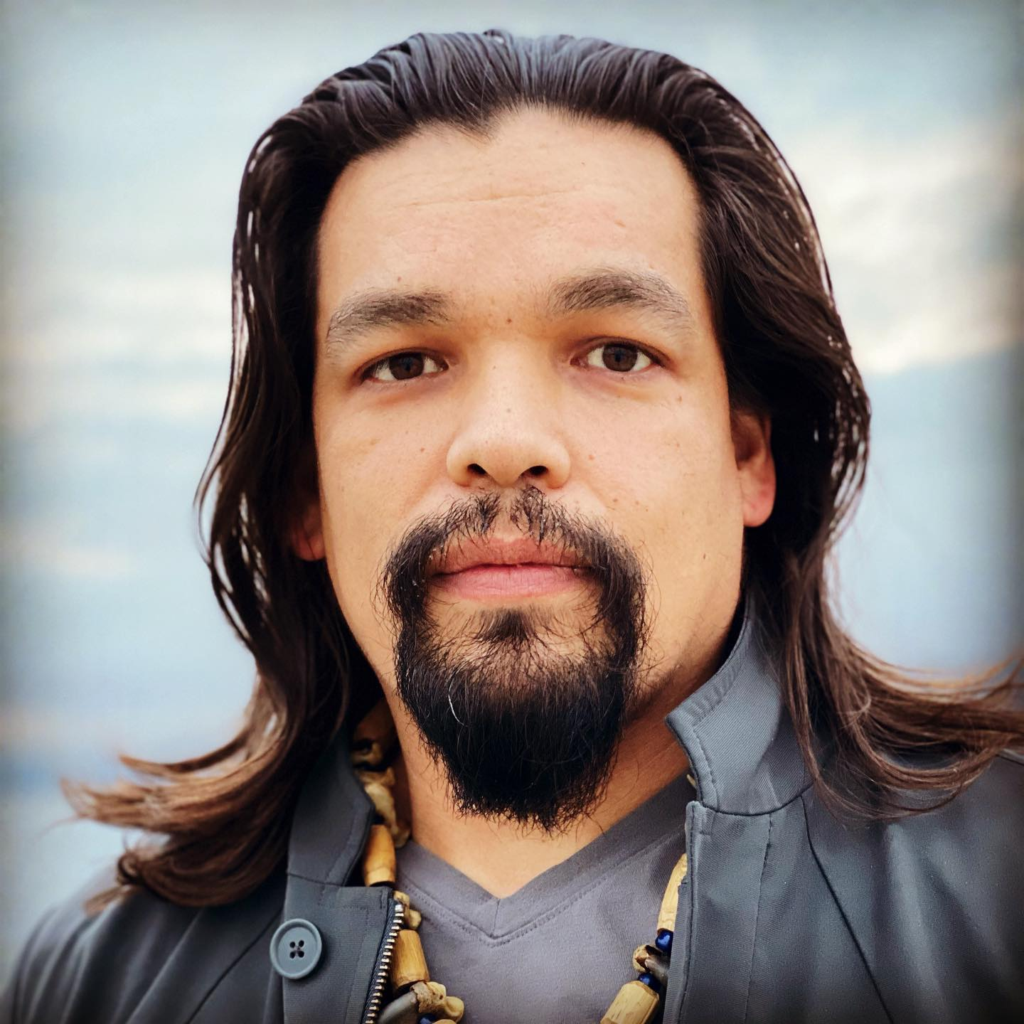
čumiłuwił-Bedroom With n̓aasʔałuk (Ahousaht/Tlaoquiaht)
A Nuu-chah-nulth Studies Multi-Media Project
Presented by the School District 70 (Pacific Rim) Indigenous Education Team.

Slide 2
Watch the Video Video Link

Slide 3
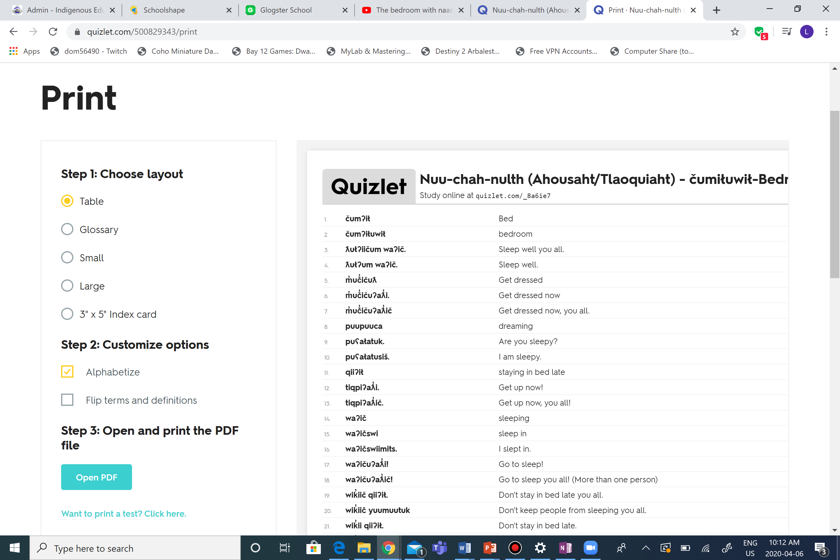
Practice
Click on the Quizlet link to practice your kitchen vocabulary.
15. puupuuca dreaming
16. ƛułʔum waʔič. Sleep well.
17. ƛułʔiičum waʔič. Sleep well you all.
18. waʔičswi sleep in
19. waʔičswiimits. I slept in.
20. čumʔił Bed
21. m̓uč̓ičuʔaƛ̓i. Get dressed now
22. m̓uč̓ičuƛ Get dressed
23. m̓uč̓ičuʔaƛ̓ič Get dressed now, you all.
24. yaaʔakuks suutił. I love you.
25. ʔiiḥmisuks suutił. You are precious to me.
26. yaaʔakuks siihił. I love you all.
27. ʔiiḥmisuks siihił. You are all precious to me.
28. m̓uč̓ičtup clothing
1. čumʔiłuwił bedroom
2. waʔič sleeping
3. waʔičuʔaƛ̓i! Go to sleep!
4. waʔičuʔaƛ̓ič! Go to sleep you all! (More than one person)
5. tiqpiʔaƛ̓i. Get up now!
6. tiqpiʔaƛ̓ič. Get up now, you all!
7. qiiʔił staying in bed late
8. wik̓ii qiiʔił. Don't stay in bed late.
9. wik̓iič qiiʔił Don’t stay in bed late you all.
10. yuumuutuk Keeping people from sleeping
11. wik̓ii yuumuutuk. Don’t keep people from sleeping.
12. wik̓iič yuumuutuk Don’t keep people from sleeping you all.
13. puʕałatusiš. I am sleepy.
14. puʕałatuk. Are you sleepy?
**Quizlet tip: Click on the three dots , choose print, then print your own flash cards or click on the link. Flash Cards

Slide 4
Test Your Self
Choose the test option in Quizlet
Click on options, check off English. Now the questions will be in Nuu-chah-nulth and the answers in English.
Press Create new test
Take the test
Check your answers.
Screenshot your best test.

Slide 5
Now It’s Your Turn - Make your own bedroom vocabulary video using the vocabulary you just learned and practiced.
Criteria Checklist
The video is well structured (with e.g. introduction & conclusion).
The video includes learned vocabulary.
The video does not exceed 6 minutes.
The video includes at least one word or phrase from another quizlet set.
The video is understandable.
The video uses examples which are suitable and authentic.
The video is original, creative and unique.
Pronunciation is clear and easy to understand.
Rate of speech is not too fast or too slow.
Ideas are organized in a meaningful way.
Any visual aids that are used are easy to see or read.

Slide 6
Self - Assessment
Project: siqiiłuwił-The Bedroom
My pronunciation was clear and easy to understand.
My rate of speech was not too fast or too slow.
My voice varied in pitch; it was not monotone.
I organized ideas in a meaningful way.
Any visual aids used (objects, words, etc.) were easily viewed or read by the entire audience.

Slide 7
Submit Video
Upload your video. You can use YouTube, google photos, google drive and drop box.
Send a link of your video and your screenshot of your test to your teacher via email.
Remember your teacher’s email is the first letter of their first name, their whole last name, @sd70.bc.ca ex. if your teacher is John Cedar email would be jcedar@sd70.bc.ca

Slide 8
Contact Us
Presented by the School District 70 (Pacific Rim) Indigenous Education Team. For more information on this lesson or others contact us at:
ltremblay@sd70.bc.ca, ptatoosh@sd70.bc.ca, or dmaher@sd70.bc.ca
We are also on:

